Slide 1
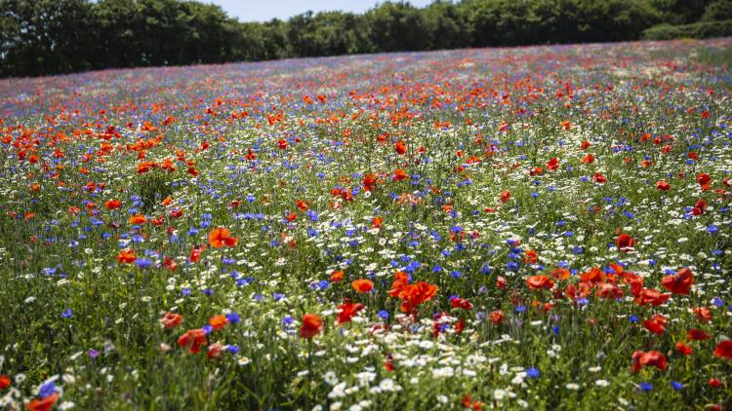
Paradise Pastures - An ‘Invisible World’

Slide 2
How does the Paradise Pastures Project Work?
For the first few sessions we will be getting to know an area of our school grounds known as ‘Paradise Pastures’, developing our practical science skills and exploring the nature in our school grounds.
After that you will come up with your own scientific question to investigate based on something that has interested you, decide how best to answer that question and then plan and complete an investigation to in order to answer your question.

Slide 3
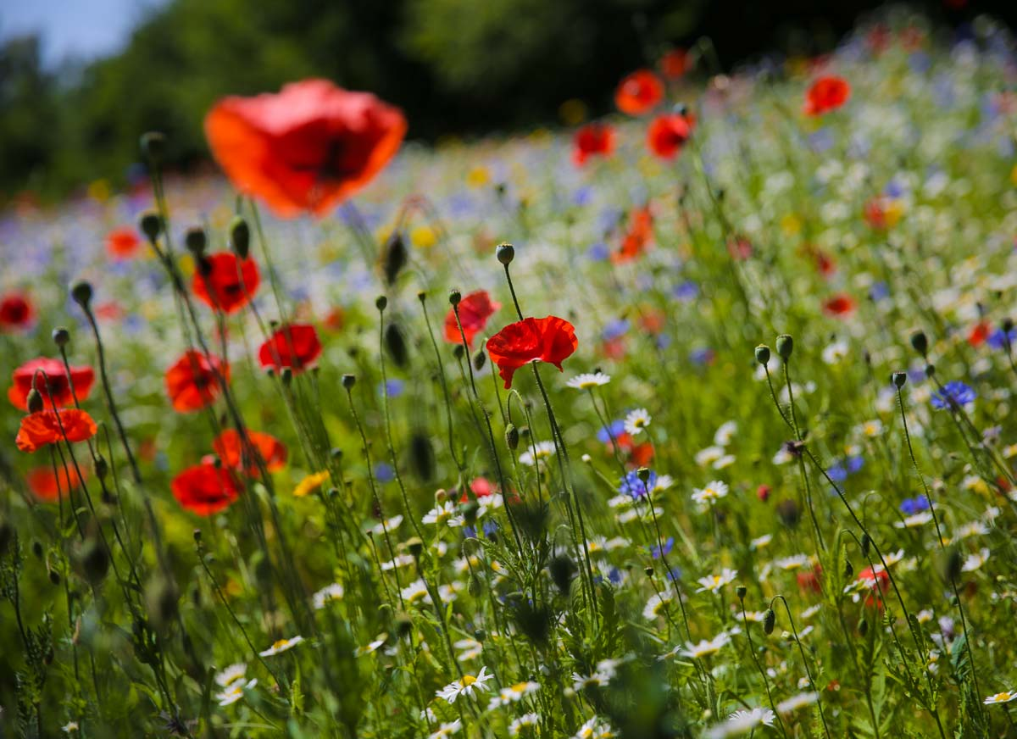
Outcomes for today’s lesson:
Explain what we mean by the word ‘biodiversity’.
Observe and identify living things in their habitat.
Practice using scientific equipment to take measurements, recording what you find.
Discuss how conditions in the environment affect living things.

Slide 4
BIODIVERSITY
What is it?
‘Variety of life’ – the number of different types of living things in a habitat.

Slide 5
We are the ‘Whatifs’. We enjoyed a peaceful, sleepy winter sheltered underneath the fallen leaves of autumn and have recently been enjoying the bright spring days. As we edge towards summer the plants here in Paradise Pastures have begun growing furiously in the longer, warm days. Life seemed like it couldn’t get better!
However, we have received warning through the ‘Wood Wide Web’, that the ‘Justsos’ have been getting their strimmer ready and that a dreaded ‘mowing’ is just around the corner. The ‘Justsos’ are only trying to keep things tidy, but the problem is that they tend it like everything around the place to look ‘Justso’. However, we know that if they left Paradise Pastures alone to grow more wild then that would be good for the plants, animals and fungi. As in - ‘Whatif they just left it alone?’
If only they could take a closer look! We need you to help us by helping them to see just how amazing and interesting our ‘Invisible World’ of Paradise Pastures is so that they can realise that the best way to help might actually be to let it grow a little wild!
Over the next few lessons we have 3 challenges for you to complete and 3 tinctures for you to drink, which we think will help you find out about the amazing Invisible world of Paradise Pastures. We have asked your teacher to draw a giant map of Paradise Pastures for you on the wall. This will come handy as a place for recording what you find out. Good luck!

Slide 6
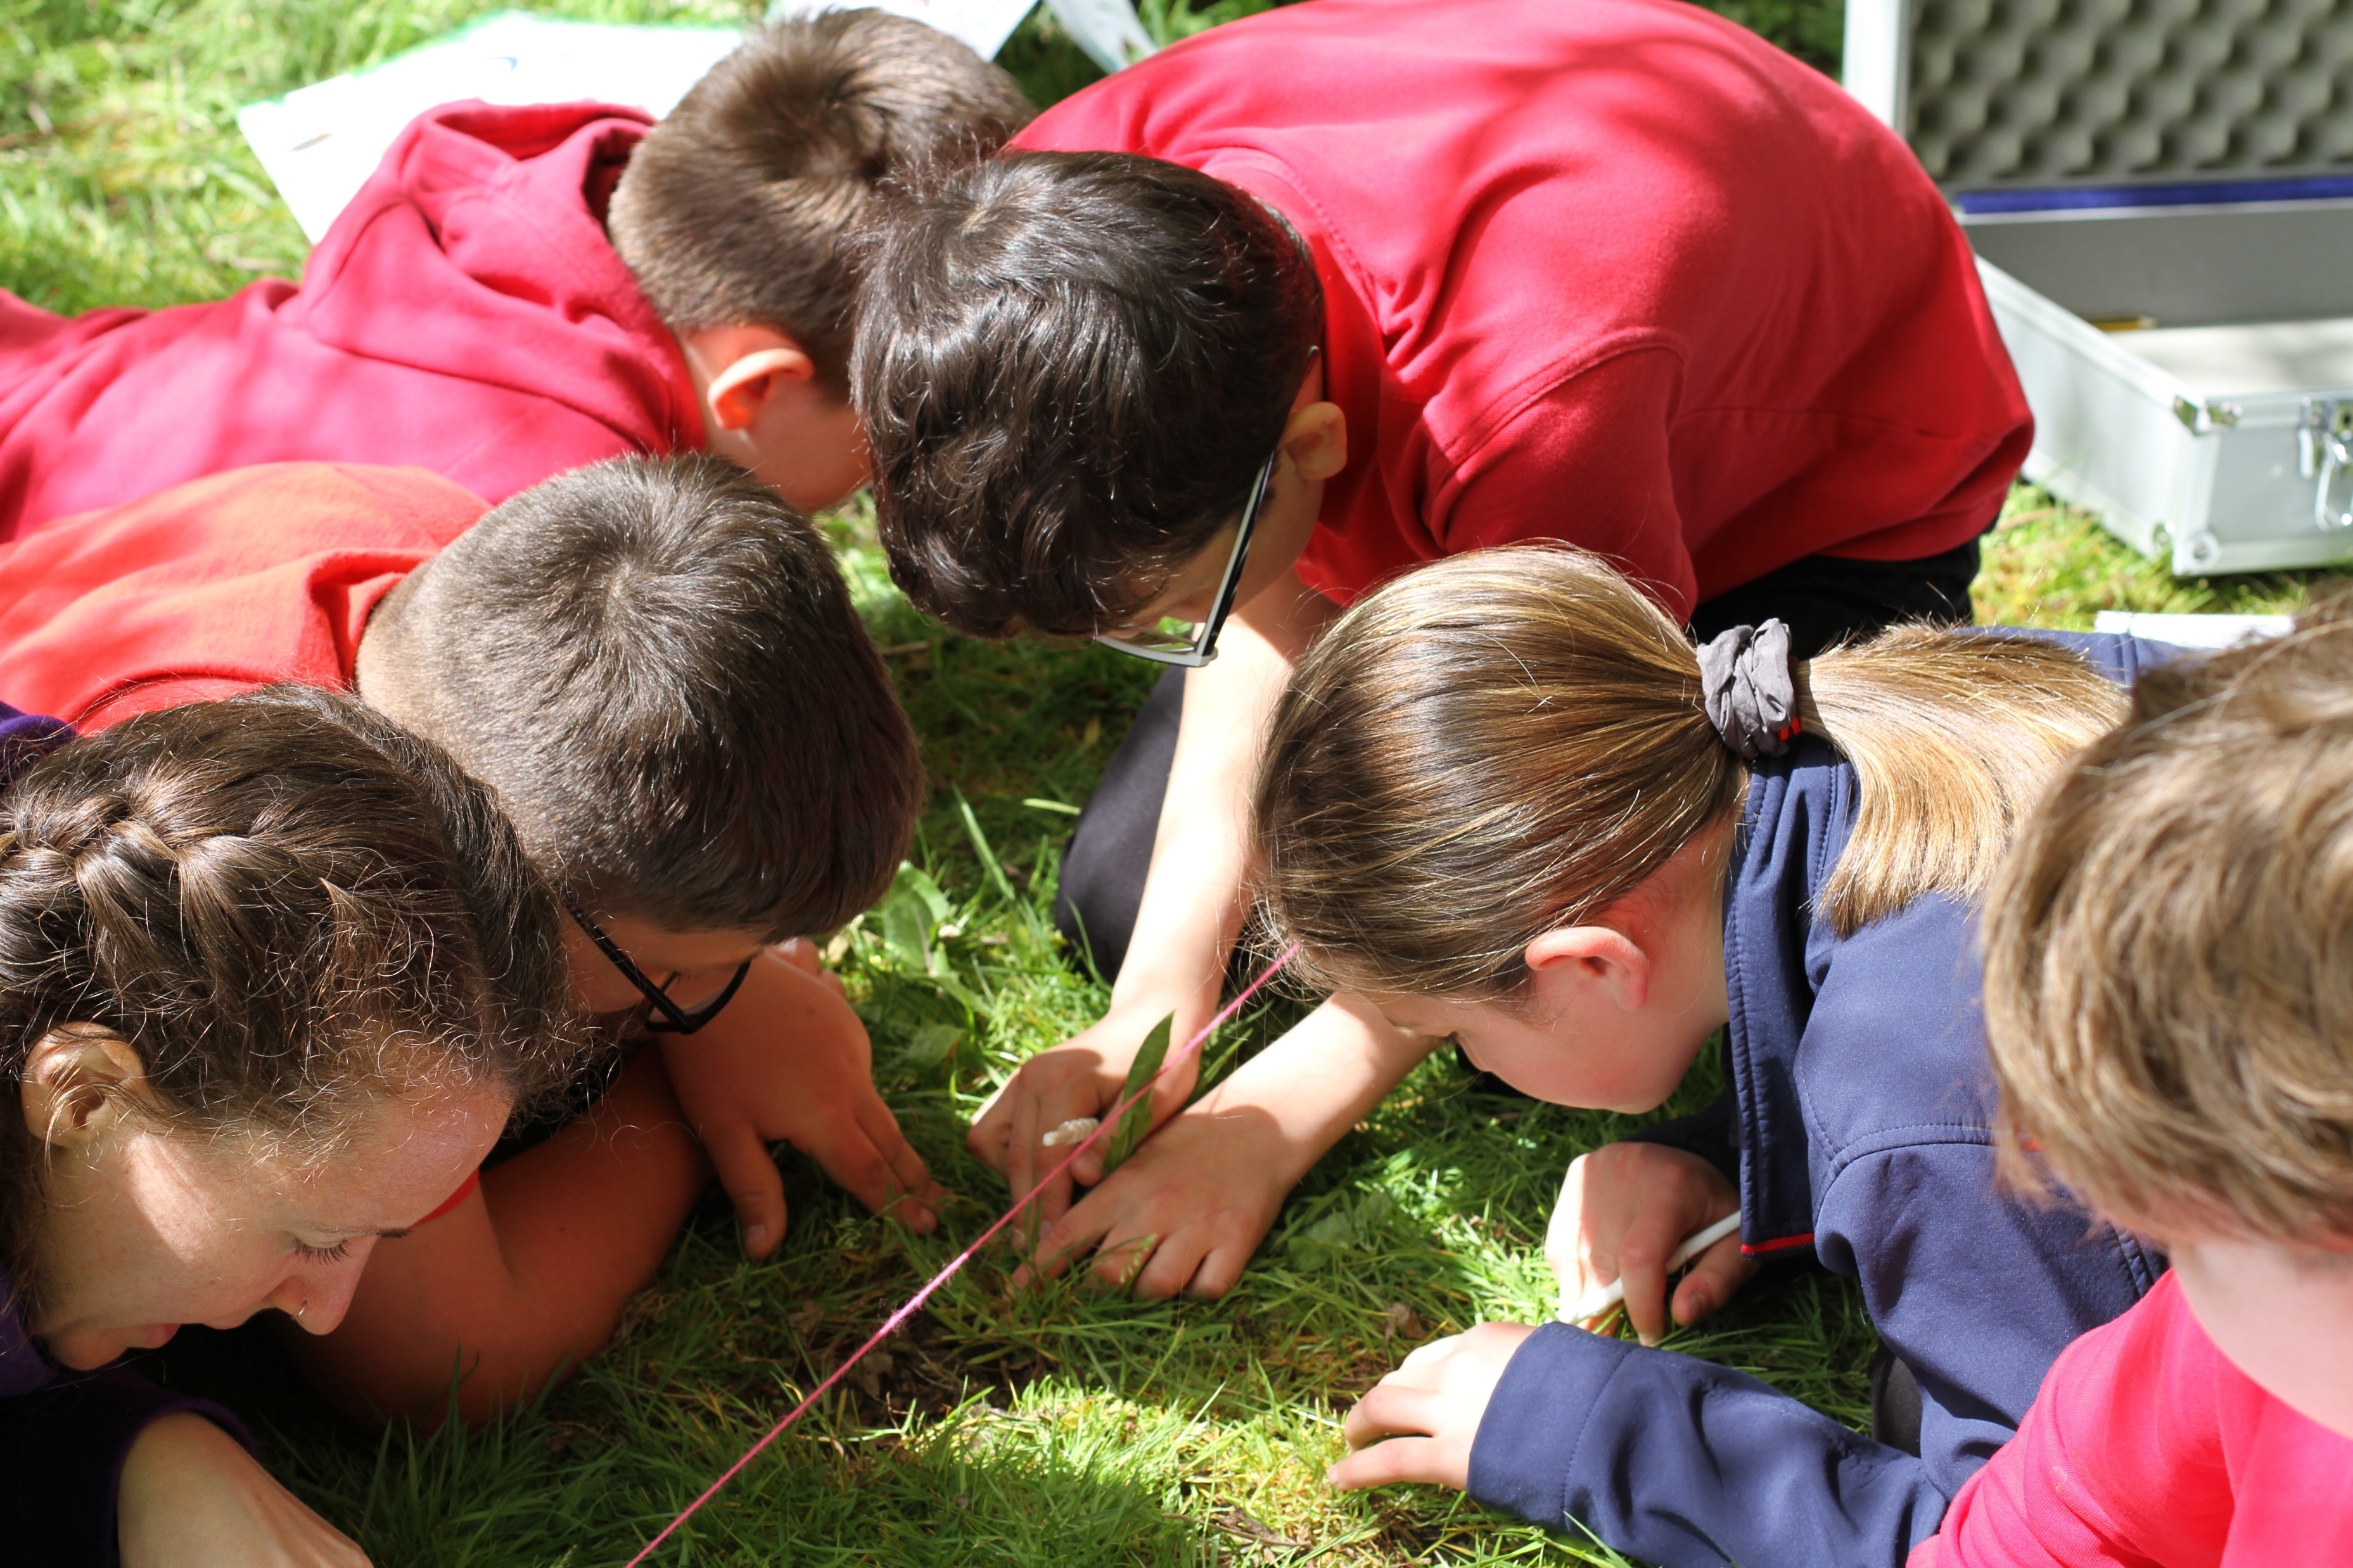
What did you learn from your Microhike?
What was the location like? Exposed? Sheltered?
How tall was the vegetation?
What sorts of things did you find – animals and plants? Decomposing leaves?
What else did you notice? Anything surprising?
What would you like to know more about?

Slide 7
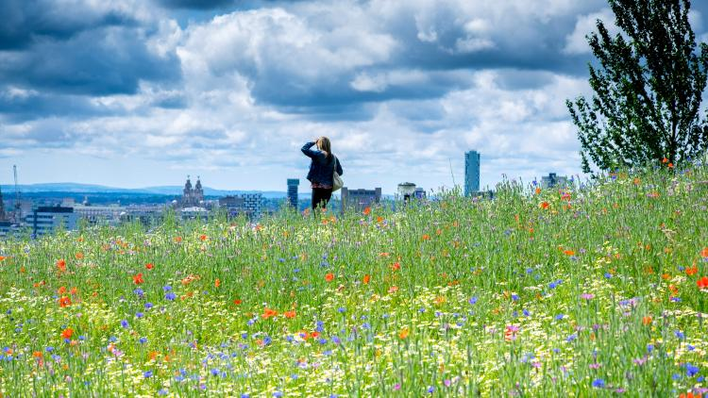
Finally
It is likely that you have visited Paradise Pastures many times before.
Maybe you play there every day at break and lunchtime.
Tell the person next to you one thing that you learnt about that place that you had never thought or noticed before.

Slide 8
Outcomes for today’s lesson:
Explain what we mean by the word ‘biodiversity’.
Observe and identify living things in their habitat.
Practice using scientific equipment to take measurements, recording what you find.
Discuss how conditions in the environment effect living things.

